Slide 1

Sales Performance Analysis Project
Analyzing Superstore dataset to uncover key business insights, sales trends, and profit patterns for better decision-making using Python data science tools.

Slide 2

Tools & Technologies
Python
Pandas & NumPy
Core programming language for data analysis
Data manipulation, cleaning, and numerical computation
Matplotlib & Seaborn
Google Colab
Creating insightful visualizations and charts
Cloud-based coding environment

Slide 3
Dataset Overview
Sales Data Structure
20+
The Superstore dataset contains comprehensive sales transactions with customer details, order information, and product-level data across multiple regions.
Data Columns
Order & shipping details with dates and modes
Comprehensive attributes
Customer segments: Consumer, Corporate, Home Office
Product categories: Furniture, Technology, Office Supplies
3
Financial metrics: Sales, Quantity, Discount, Profit
Geographic data: Country, Region, State, City
Categories
Product segments

Slide 4
Data Preparation Process
01
02
03
Import & Load
Initial Exploration
Data Quality Check
Imported libraries (pandas, numpy, matplotlib, seaborn) and loaded dataset using pd.read_excel()
Displayed first rows using head() and checked structure with info()
Checked for missing and duplicate values to ensure data integrity
04
05
Date Transformation
Feature Extraction
Converted Order Date and Ship Date to datetime format
Extracted Order Year and Order Month for time-based analysis

Slide 5
Feature Engineering
1
2
3
Profit Category
Sales After Discount
High Sales Flag
Classified profit levels into three tiers:
Calculated final sales value using NumPy:
Created binary flag to identify high-value transactions:
High: Profit greater than 100
Sales After Discount = Sales × (1 - Discount)
Yes: Sales amount > 500
Medium: Profit 0-100
No: Otherwise
Low: Profit ≤ 0
Rounded to 2 decimal places for readability.
Helps understand product and regional profitability distribution.

Slide 6

Top Performing Products
Identified the top 5 products contributing the most to overall sales using groupby and sorting analysis.
Certain technology and office supply items dominate sales performance, providing clear targets for inventory optimization and marketing focus.

Slide 7

Sales Trends Analysis
Year-over-Year Growth
Grouped total sales by Order Year and visualized growth trends using line charts.
The analysis reveals clear patterns in sales performance across multiple years, showing periods of growth and potential seasonal variations.
Orders Peak in Specific Months
Seasonal demand patterns identified, showing potential opportunities for targeted marketing campaigns during high-volume periods.

Slide 8
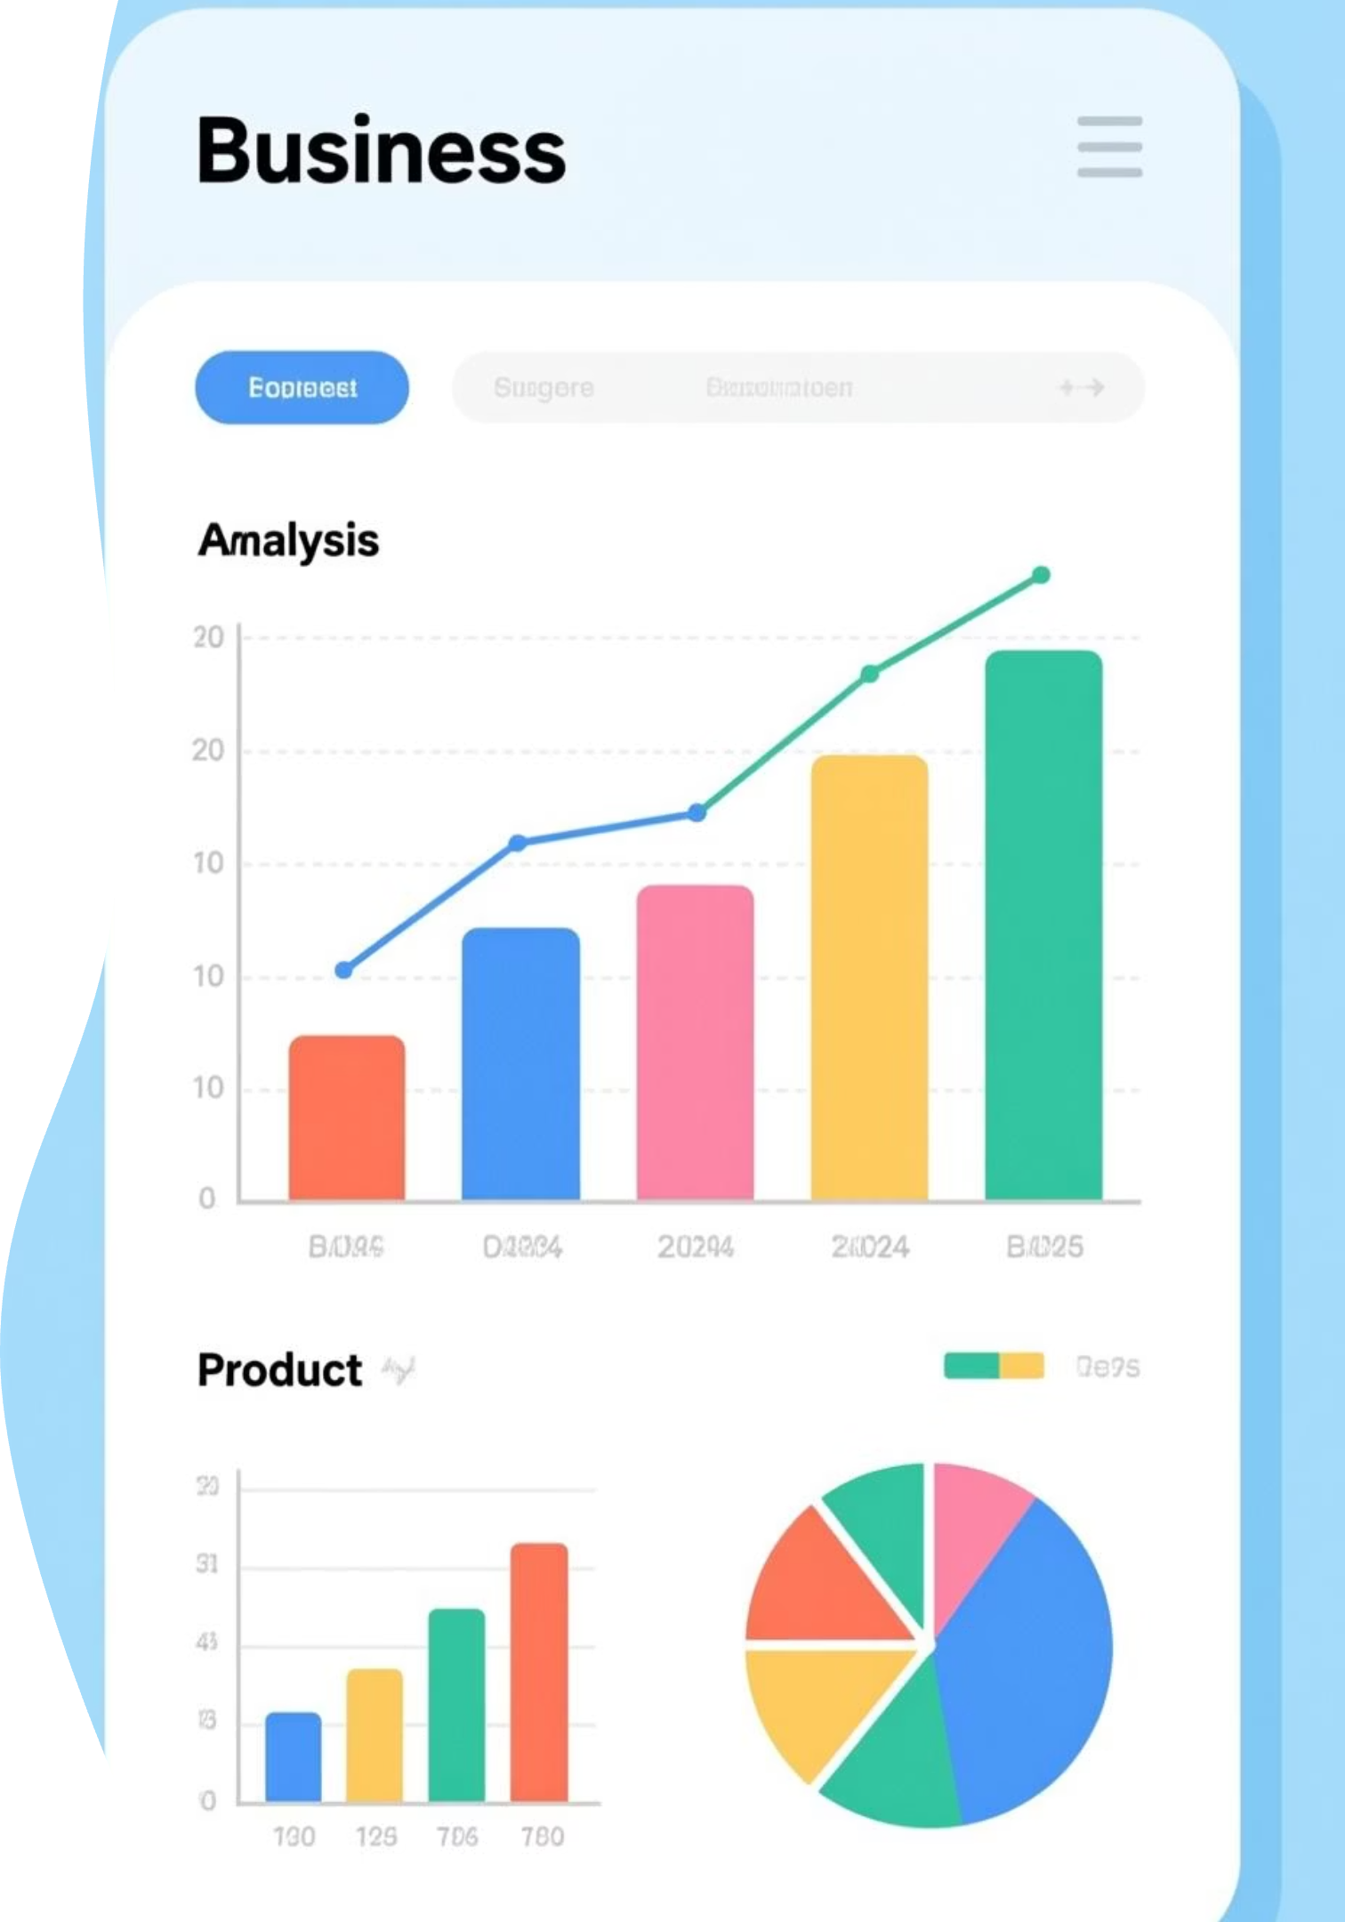
Category Performance
Technology
Office Supplies
Strong sales performance with consistent profit margins across product lines.
High volume transactions contributing significantly to overall revenue.
Furniture
Variable profit margins requiring strategic pricing optimization.
Aggregated total sales and profit for each category, visualized with bar charts using Seaborn to identify performance patterns and opportunities.

Slide 9
Key Insights
1
Top Products Drive Revenue
Technology and office supply items contribute the most to sales performance.
2
Profitable Segments
Corporate and Consumer segments generate consistent profit margins.
3
Seasonal Demand Patterns
Orders peak in specific months, showing clear seasonal trends.
4
Regional Performance Variance
Some regions outperform others in both sales and profitability.
5
High Profit Variability
Significant variation in profit margins across different product categories.

Slide 10


Conclusion & Impact
Actionable Business Intelligence
The Superstore Sales Analysis provides actionable insights for improving marketing strategies, optimizing inventory, and maximizing profit.
Project Achievements
Comprehensive data cleaning and transformation
Strategic feature engineering
Exploratory visualization techniques
Logical and statistical insight generation
Next Steps: Implement findings through targeted marketing campaigns, inventory optimization, and regional strategy adjustments to drive revenue growth.

